Slide 1
Chapter 22 Carbonyl Alpha-Substitution Reactions

Slide 2
Learning Objectives
(22.1)
Keto-Enol tautomerism
(22.2)
Reactivity of Enols: α-substitution reactions
(22.3)
Alpha halogenation of aldehydes and ketones
(22.4)
Alpha bromination of carboxylic acids

Slide 3
Learning Objectives
(22.5)
Acidity of alpha hydrogen atoms: Enolate ion formation
(22.6)
Reactivity of enolate ions
(22.7)
Alkylation of enolate ions

Slide 4
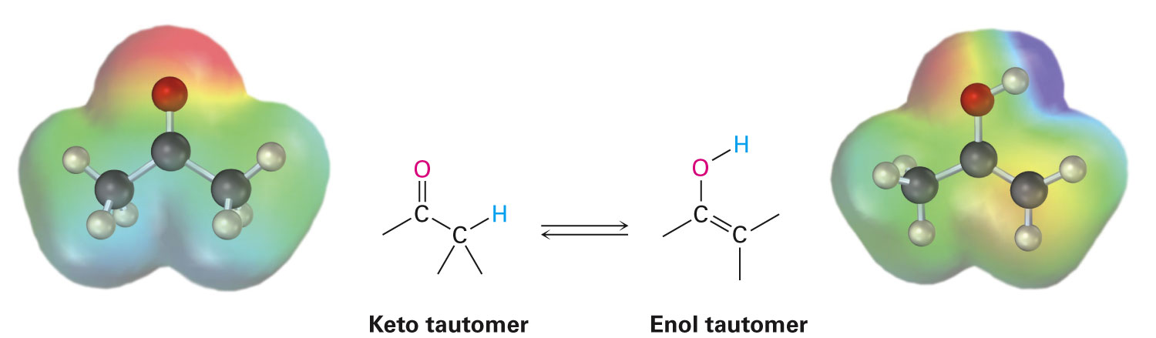
Keto-Enol Tautomerism
A carbonyl compound with a hydrogen atom on its α carbon rapidly equilibrates with its corresponding enol isomer
Tautomers: Isomers that interconvert spontaneously, usually with the change in position of a hydrogen
Notes:
Keto–Enol tautomerism

Slide 5
Keto-Enol Tautomerism
Tautomers are constitutional isomers
Have their atoms arranged differently
Resonance forms are different representations of a single compound
Differ in the position of the π and nonbonding electrons
Most monocarbonyl compounds exist in their keto form at equilibrium
Notes:
Keto–Enol tautomerism

Slide 6
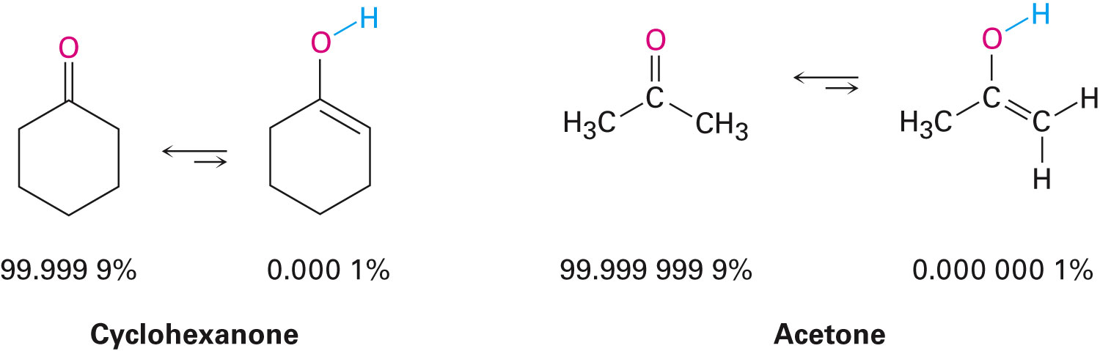
Keto-Enol Tautomerism
Enol tautomer is often present in small extent and cannot be isolated easily
Enols are responsible for much of the chemistry of carbonyl compounds
Keto-enol tautomerism of carbonyl compounds is catalyzed by both acids and bases
Notes:
Keto–Enol tautomerism

Slide 7
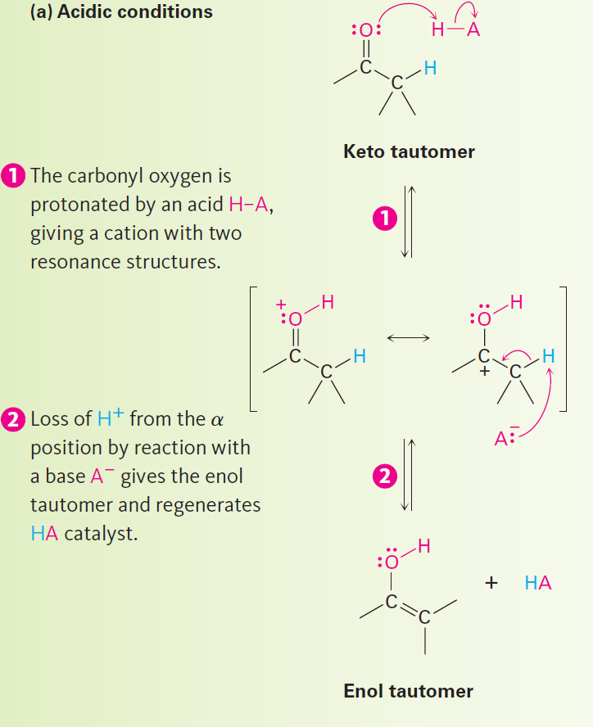
Keto-Enol Tautomerism
Acid catalysis occurs due to protonation of carbonyl oxygen atom
Notes:
Keto–Enol tautomerism

Slide 8
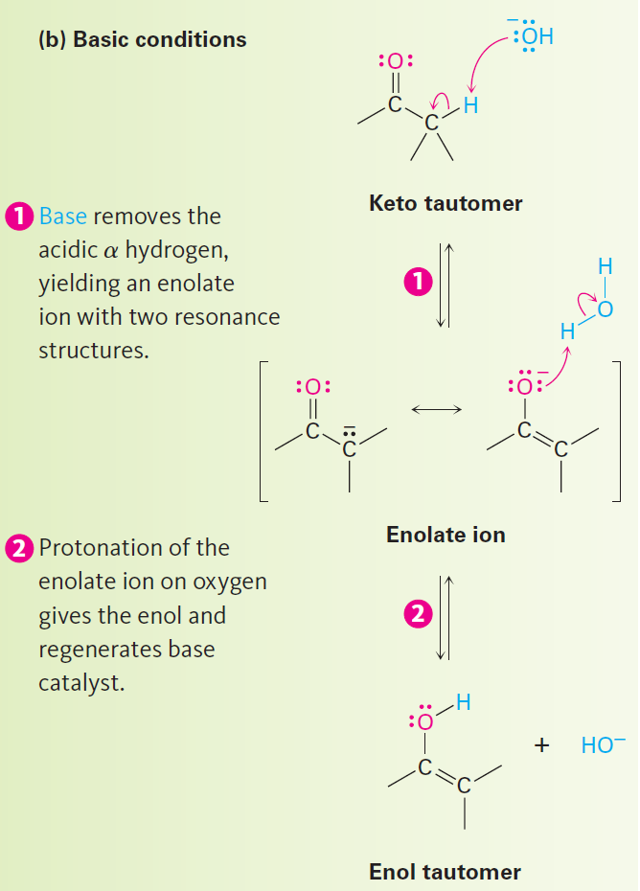
Keto-Enol Tautomerism
Carbonyl compound can act as an acid and donate one of its a hydrogens to a sufficiently strong base, yielding an enolate ion
Notes:
Keto–Enol tautomerism

Slide 9
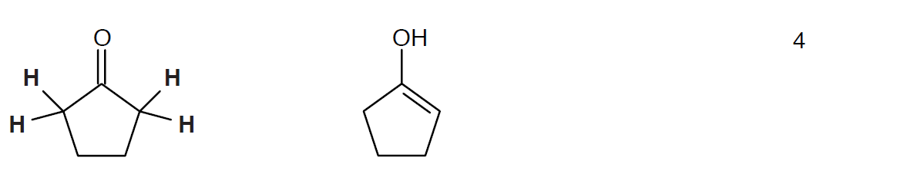
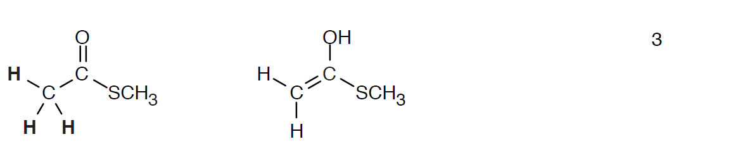
Worked Example
Draw structures for the enol tautomers of the following compounds:
a) Cyclopentanone
b) Methyl thioacetate
Solution:
a)
b)
Notes:
Keto–Enol tautomerism

Slide 10
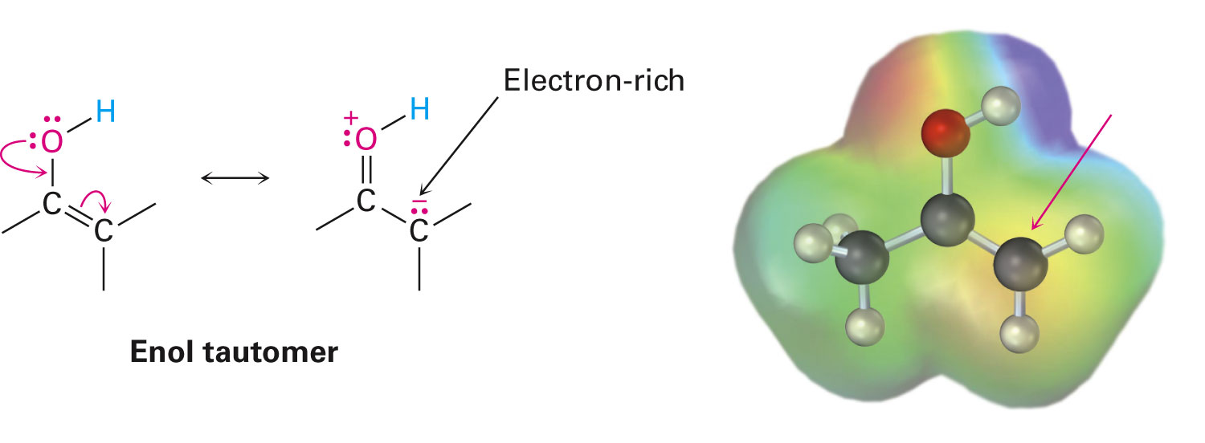
Reactivity of Enols: Alpha-Substitution Reactions
Enols behave as nucleophiles and react with electrophiles
Enols are more electron-rich and correspondingly more reactive than alkenes
Notes:
Reactivity of Enols: α-substitution reactions

Slide 11
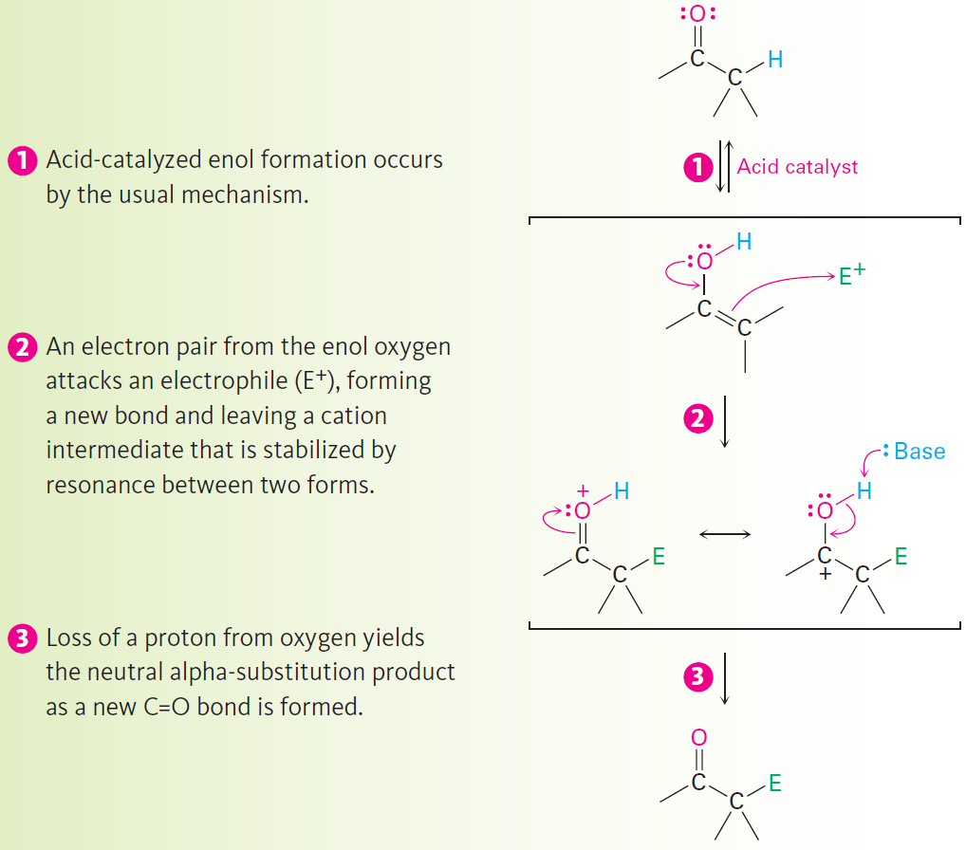
General Mechanism of Addition to Enols
When an enol reacts with an electrophile the intermediate cation immediately loses the –OH proton to give an α-substituted carbonyl compound
Notes:
Reactivity of Enols: α-substitution reactions

Slide 12
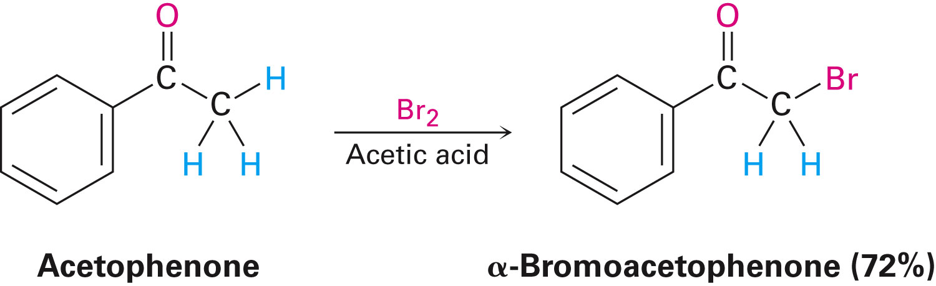
Alpha Halogenation of Aldehydes and Ketones
Aldehydes and ketones can be halogenated at their α positions by reaction with Cl₂, Br₂, or I₂ in acidic solution
Ketone halogenation also occur in biological systems

Slide 13
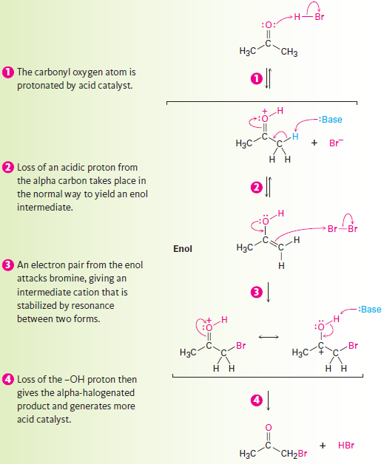
Alpha Halogenation of Aldehydes and Ketones
α-substitution reaction is proceeded by acid-catalyzed formation of an enol intermediate

Slide 14
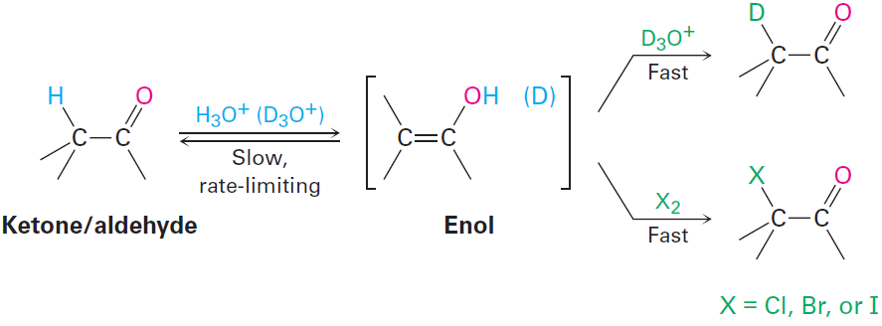
Alpha Halogenation of Aldehydes and Ketones
The rate of halogenation is independent of the halogen's identity and concentration
If an aldehyde or ketone is treated with D₃O⁺, the α hydrogens are replaced by deuterium at the same rate as halogenation
Common intermediate is involved in both processes

Slide 15
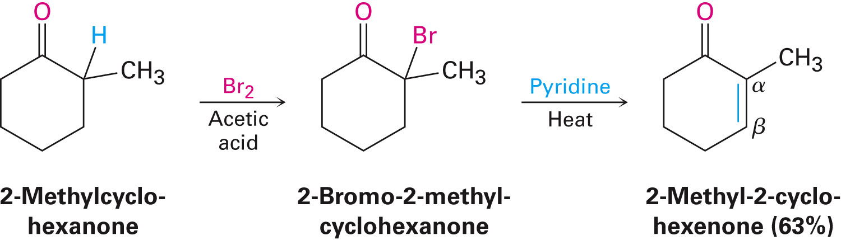
Elimination Reactions of α-Bromoketones
α-Bromo ketones can be dehydrobrominated by base treatment to yield α,β-unsaturated ketones

Slide 16
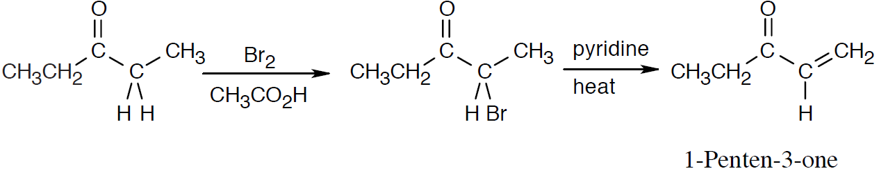
Worked Example
How to prepare 1-penten-3-one from 3-pentanone
Solution:
Alpha-bromination, followed by dehydration using pyridine, yields the enone

Slide 17
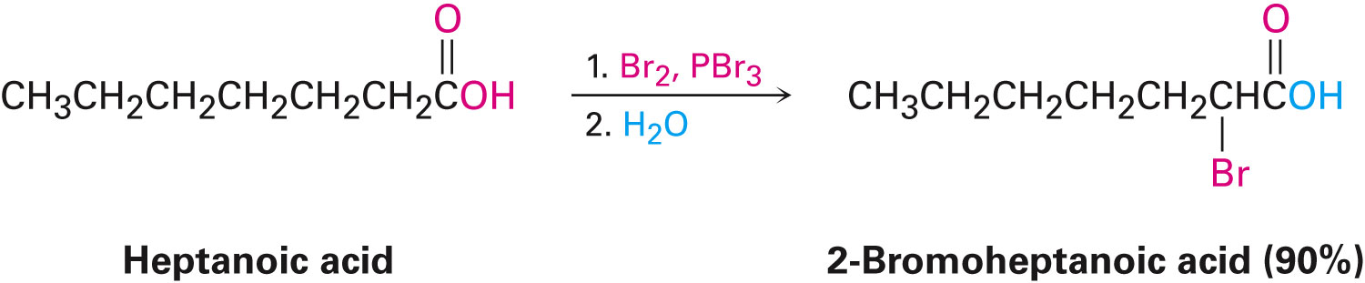
Alpha Bromination of Carboxylic Acids
Acids, esters, and amides do not react with Br₂
They are brominated by a mixture of Br₂ and PBr₃ (Hell–Volhard–Zelinskii reaction)

Slide 18
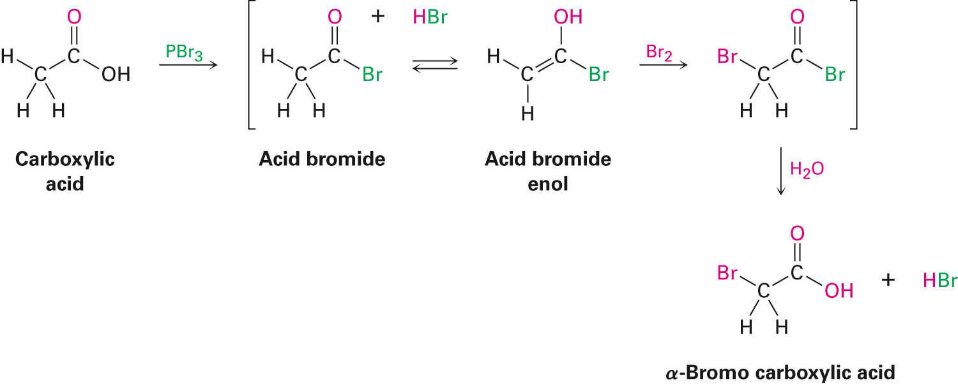
Alpha Bromination of Carboxylic Acids
PBr₃ converts –COOH to –COBr
The resultant enol reacts with Br₂ to give α-bromo acid bromide
Water is used to hydrolyze the acid bromide in a nucleophilic acyl substitution reaction to yield product

Slide 19
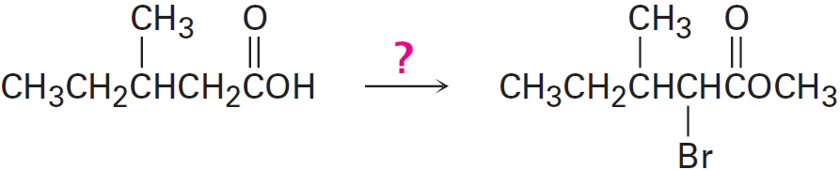
Worked Example
If methanol rather than water is added at the end of a Hell–Volhard–Zelinskii reaction, an ester rather than an acid is produced
How can the following transformation be carried out?

Slide 20
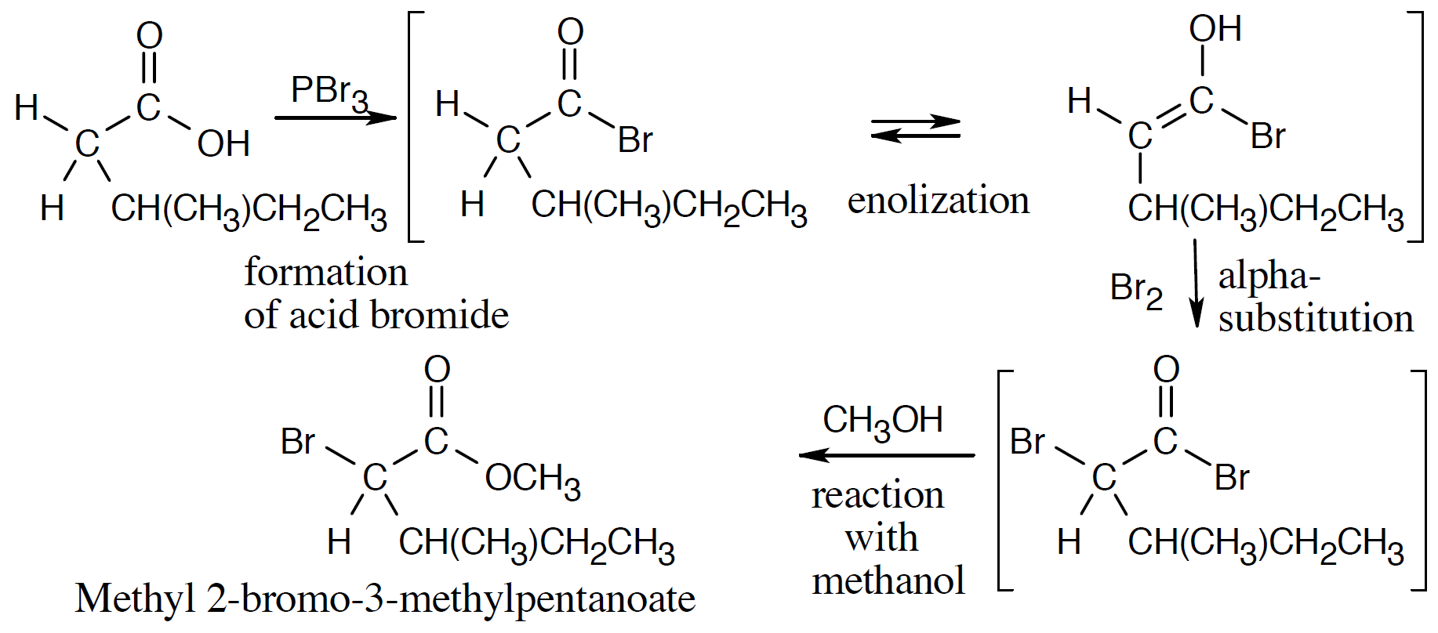
Worked Example
Solution:

Slide 21
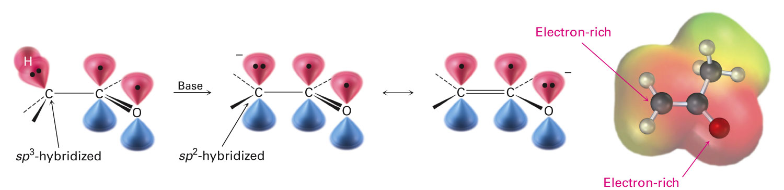
Acidity of Alpha Hydrogen Atoms: Enolate Ion Formation
Carbonyl compounds can act as weak acids
Strong base is needed for enolate ion formation
Sodium hydride (NaH) or lithium diisopropylamide [LiN(i-C₃H₇)₂] (LDA) are strong enough to form the enolate

Slide 22
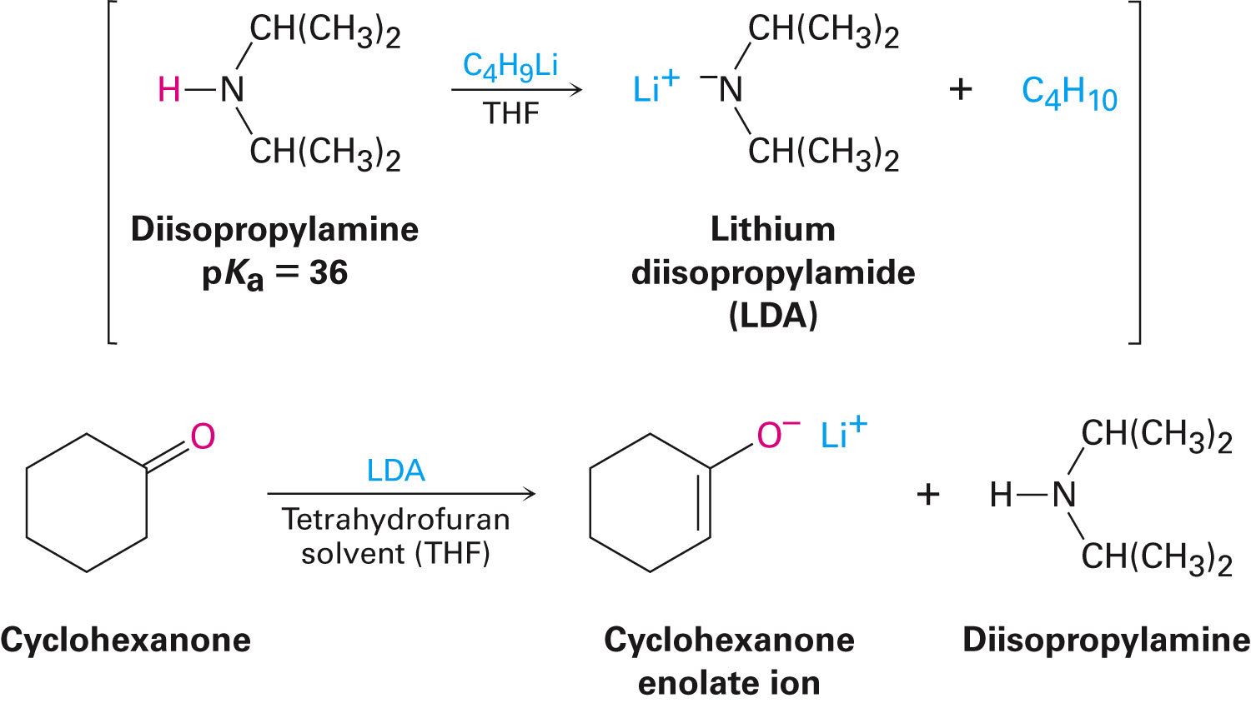
Acidity of Alpha Hydrogen Atoms: Enolate Ion Formation
LDA is from butyllithium (BuLi) and diisopropylamine (pK_{a} = 36)
Soluble in organic solvents and effective at low temperature with many compounds

Slide 23
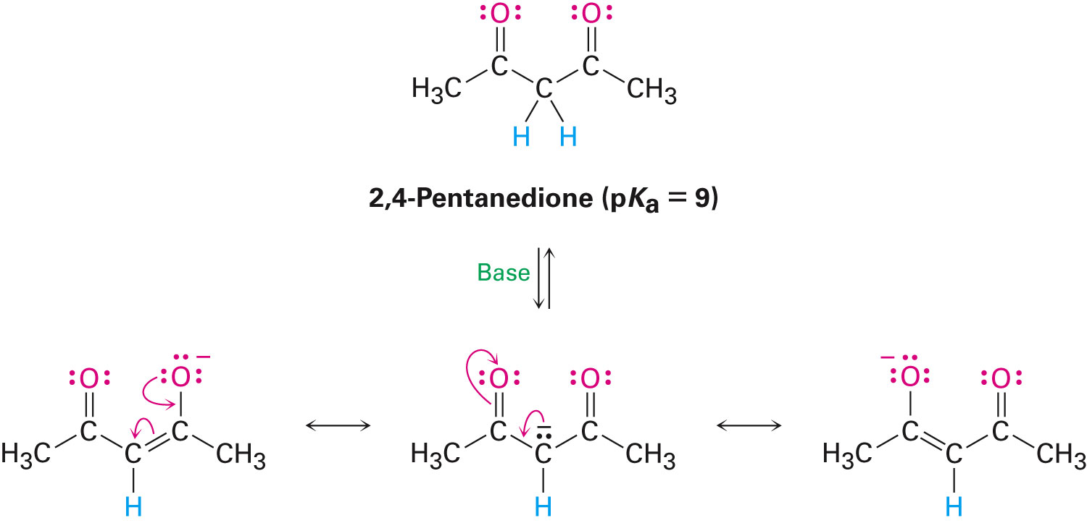
Acidity of Alpha Hydrogen Atoms: Enolate Ion Formation
When a hydrogen atom is flanked by two carbonyl groups, its acidity is enhanced
Negative charge of enolate delocalizes over both carbonyl groups

Slide 24
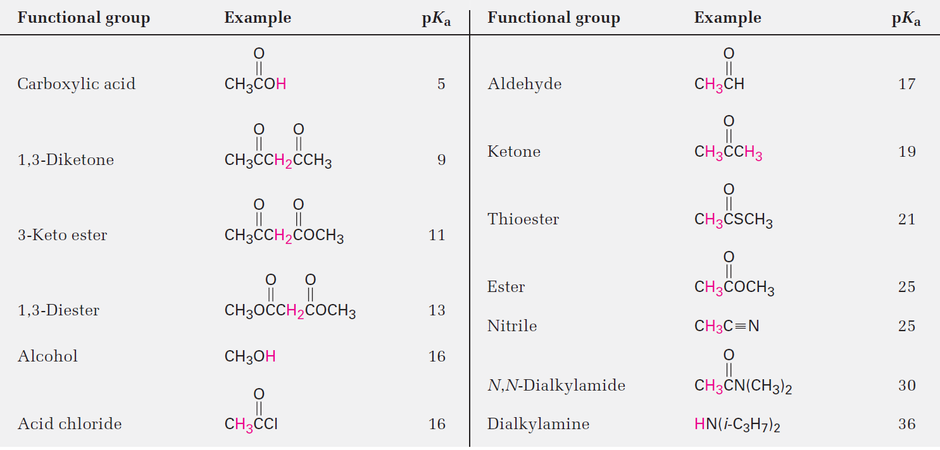
Table 22.1 - Acidity Constants for Some Organic Compounds

Slide 25
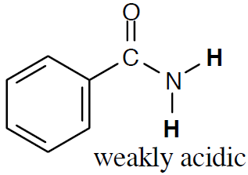
Worked Example
Identify the most acidic hydrogens in a benzamide molecule
Solution:
Hydrogens α to one carbonyl group are weakly acidic
Hydrogens α to two carbonyl groups are much more acidic, but not as acidic as carboxylic acid protons

Slide 26
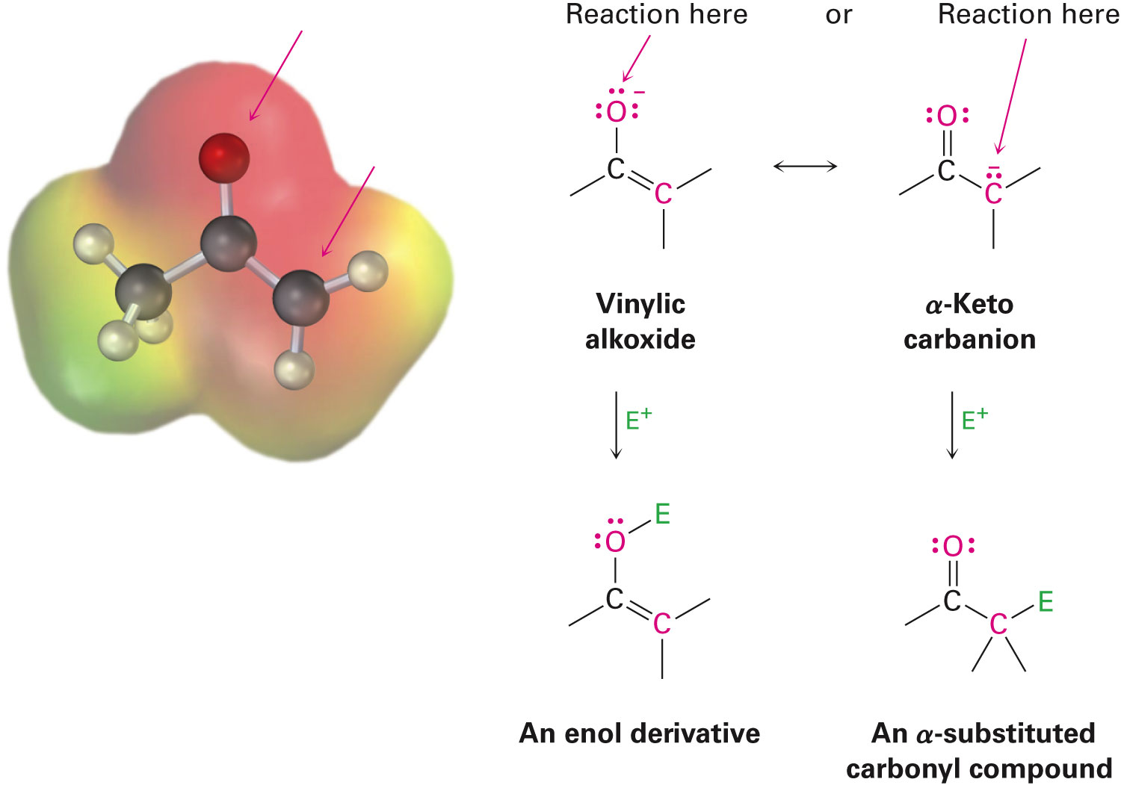
Reactivity of Enolate Ions
Enolate ions can be looked at either as vinylic alkoxides (C=C–O⁻) or as α-keto carbanions (⁻C–C=O)
Enolate ions can react with electrophiles
Reaction on oxygen yields an enol derivative
Reaction on carbon yields an α-substituted carbonyl compound

Slide 27
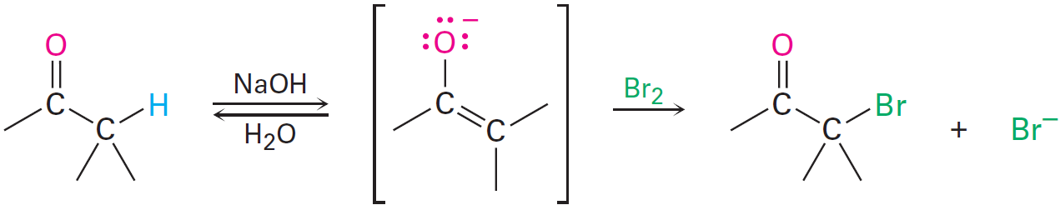
Reactivity of Enolate Ions
Aldehydes and ketones undergo base-promoted α halogenation
Weak bases are effective for halogenation because it is not necessary to convert the ketone completely into its enolate ion

Slide 28
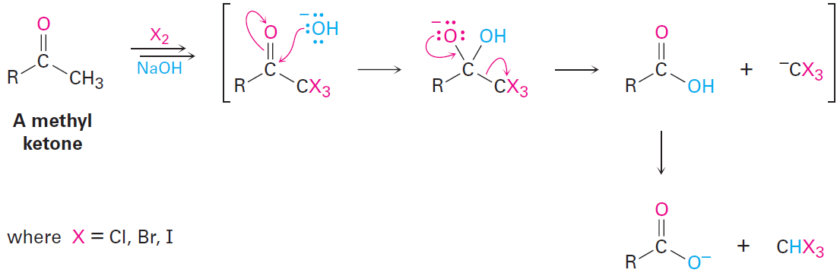
Reactivity of Enolate Ions
Base-promoted halogenation of aldehydes and ketones is seldom used
If excess base and halogen are used, a methyl ketone is triply halogenated and then cleaved by base in the haloform reaction
A halogen-stabilized carbanion acts as a leaving group

Slide 29
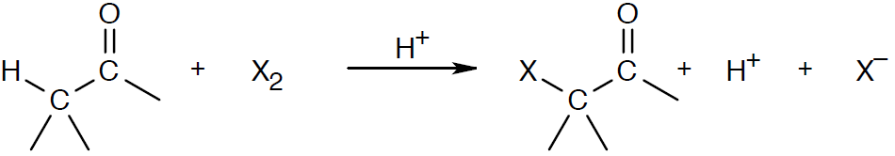
Worked Example
Why are ketone halogenations in acidic media referred to as being acid-catalyzed, whereas halogenations in basic media are base promoted?
In other words, why is a full equivalent of base required for halogenation?
Solution:
Acid-catalyzed because hydrogen ions are regenerated

Slide 30
Worked Example
Base-promoted because a stoichiometric amount of base is consumed

Slide 31
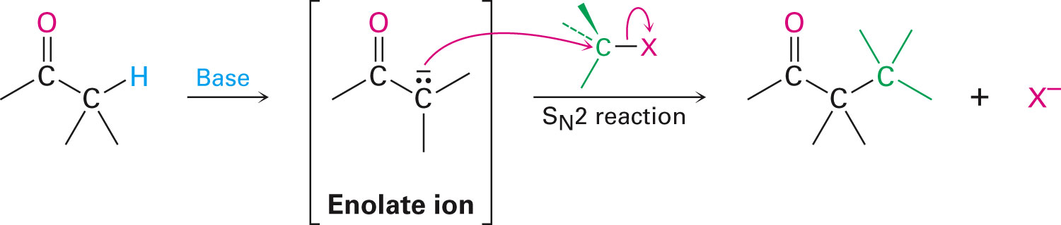
Alkylation of Enolate Ions
Base-promoted reaction occurs through an enolate ion intermediate

Slide 32
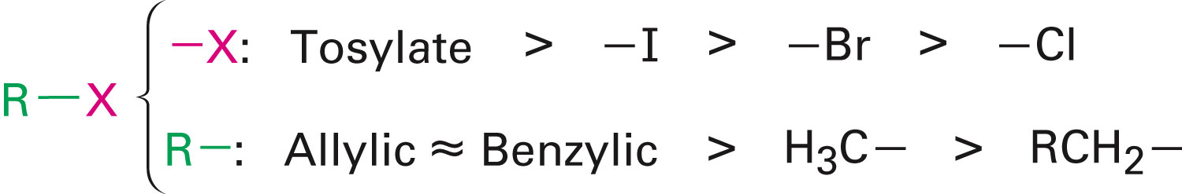
Constraints on Enolate Alkylation
S_{N}2 reaction - Leaving group X can be chloride, bromide, iodide, or tosylate
R should be primary or methyl and preferably should be allylic or benzylic
Secondary halides react poorly, and tertiary halides don't react at all because of competing elimination

Slide 33
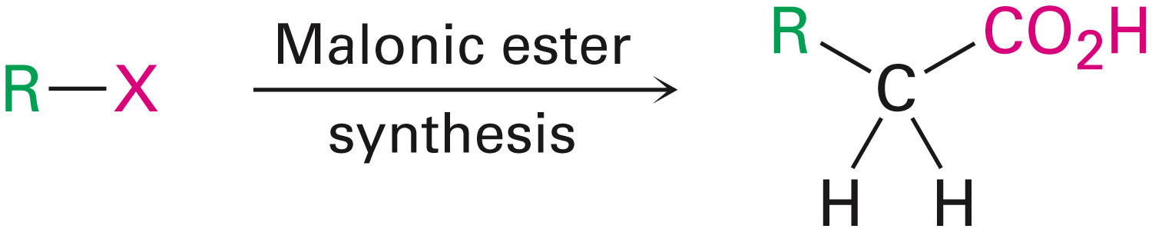
Malonic Ester Synthesis
For preparing a carboxylic acid from an alkyl halide while lengthening the carbon chain by two atoms

Slide 34
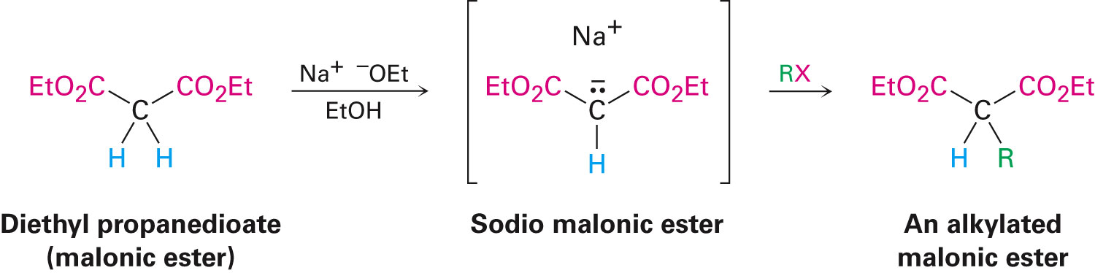
Formation of Enolate and Alkylation
Malonic ester (diethyl propanedioate) is easily converted into its enolate ion by reaction with sodium ethoxide in ethanol
The enolate is a good nucleophile that reacts rapidly with an alkyl halide to give an α-substituted malonic ester

Slide 35
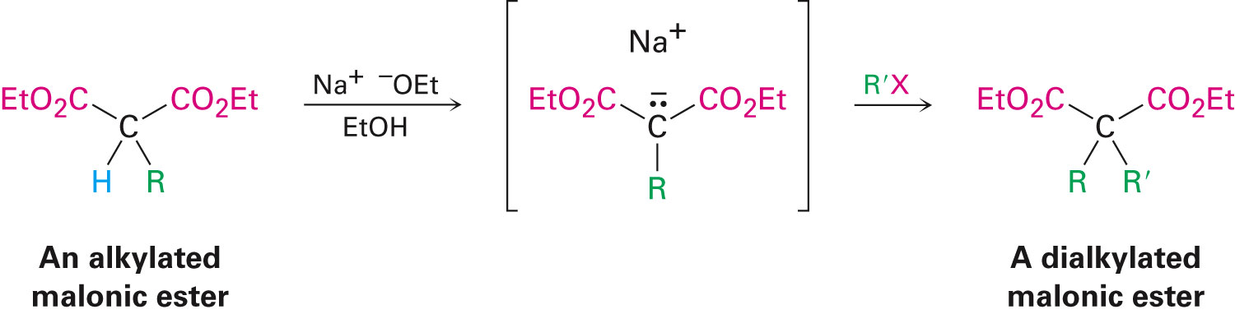
Dialkylation
The product has an acidic α-hydrogen, allowing the alkylation process to be repeated

Slide 36
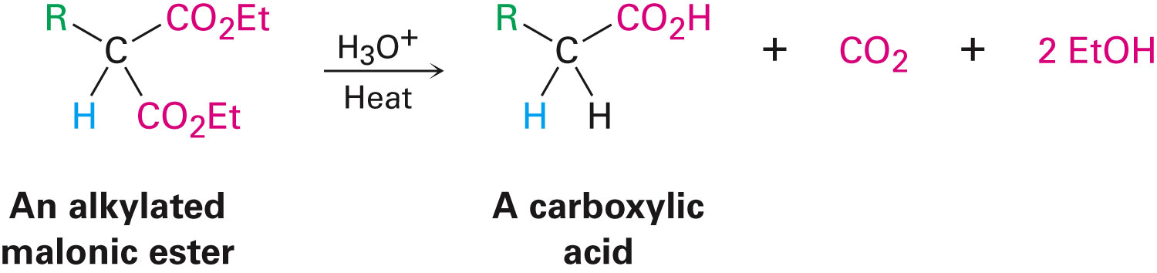
Hydrolysis and Decarboxylation
The malonic ester derivative hydrolyzes in acid and loses CO₂ (decarboxylation) to yield a substituted monoacid

Slide 37
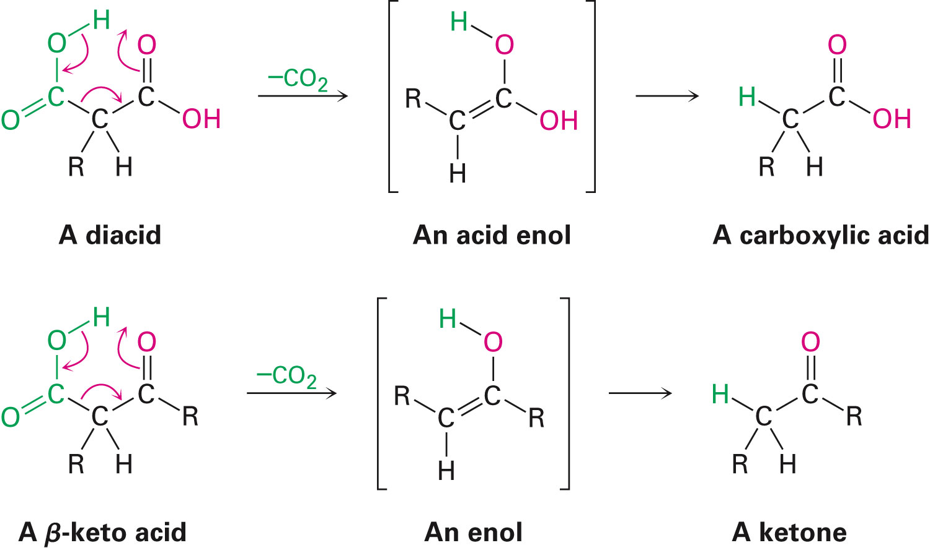
Decarboxylation of β-Ketoacids
Decarboxylation requires a carbonyl group two atoms away from the –CO₂H

Slide 38
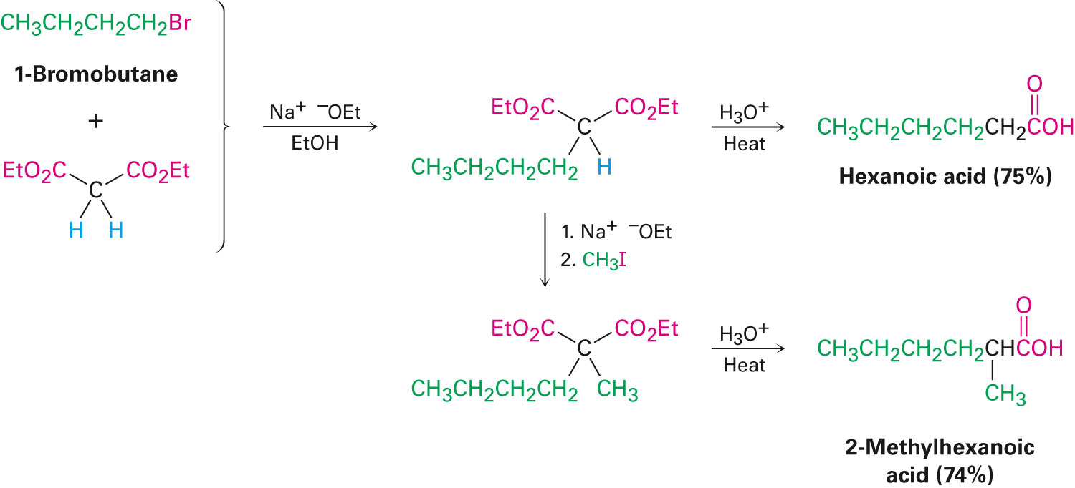
Overall Conversion
The malonic ester synthesis converts an alkyl halide into a carboxylic acid while lengthening the carbon chain by two atoms

Slide 39
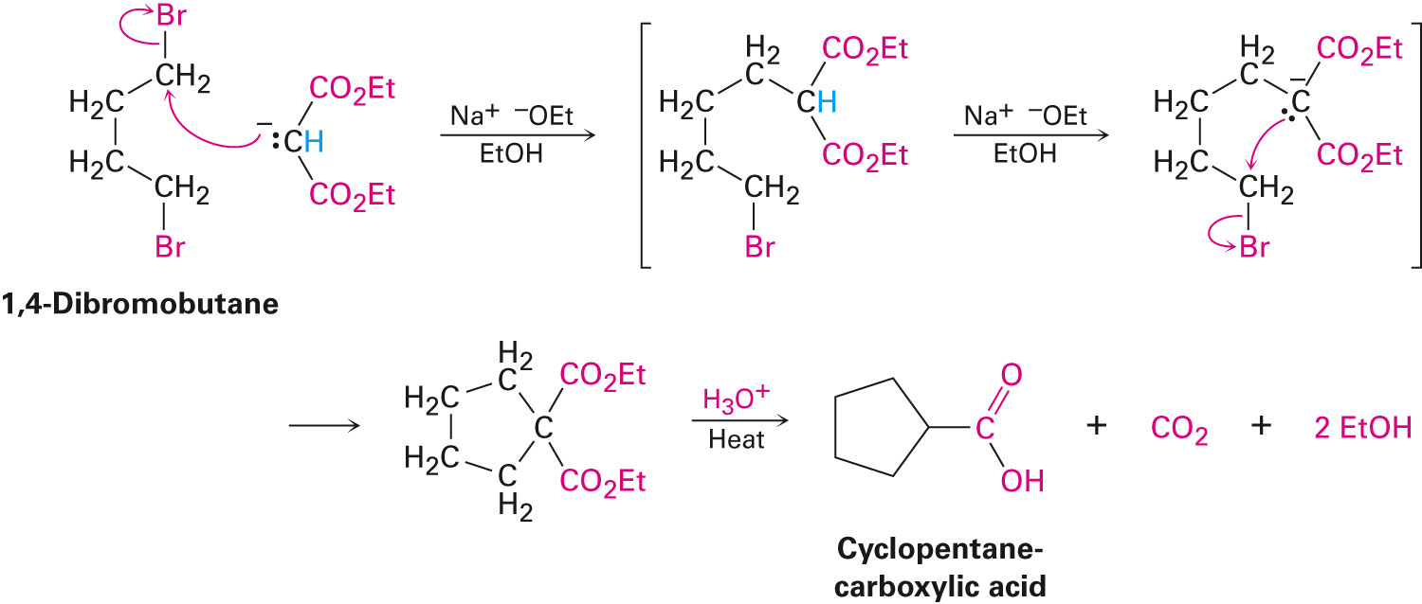
Preparation of Cycloalkane Carboxylic Acids
1,4-dibromobutane reacts twice, giving a cyclic product
Three-, four-, five-, and six-membered rings can be prepared in this way

Slide 40
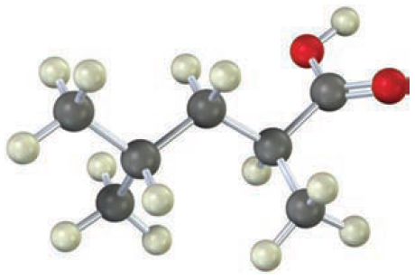
Worked Example
How could malonic ester synthesis be used to prepare the following compound

Slide 41
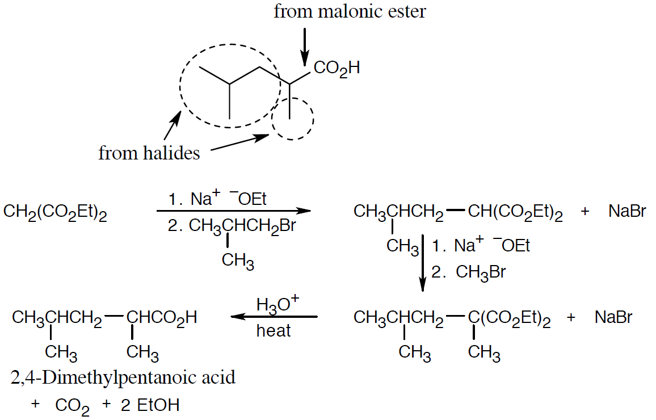
Worked Example
Solution:

Slide 42
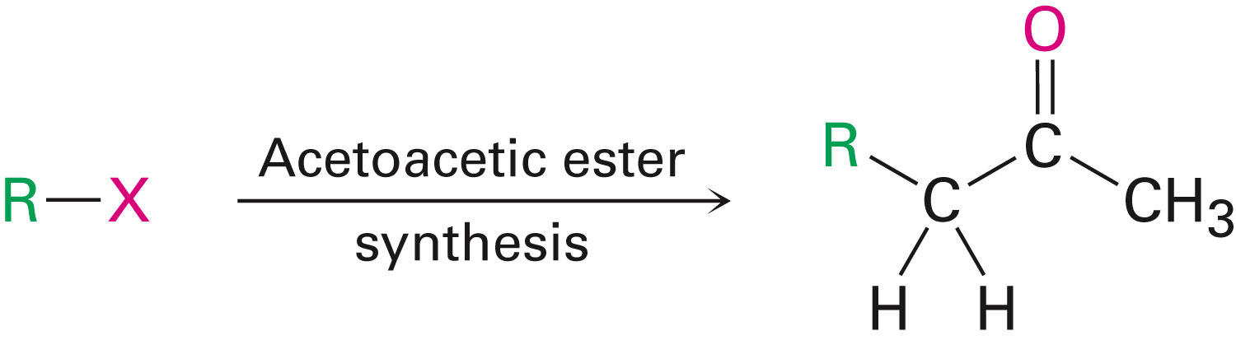
Acetoacetic Ester Synthesis
Converts an alkyl halide into a methyl ketone having three more carbons

Slide 43
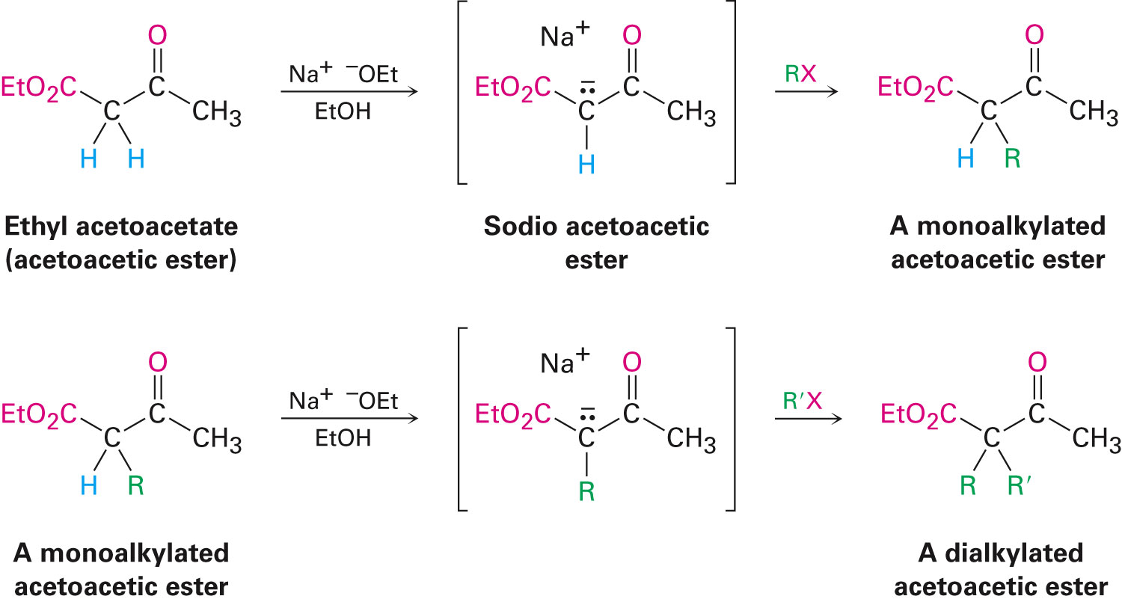
Acetoacetic Ester (Ethyl Acetoacetate)
α carbon is flanked by two carbonyl groups, so it readily becomes an enolate ion
This can be alkylated by an alkyl halide and also can react with a second alkyl halide

Slide 44
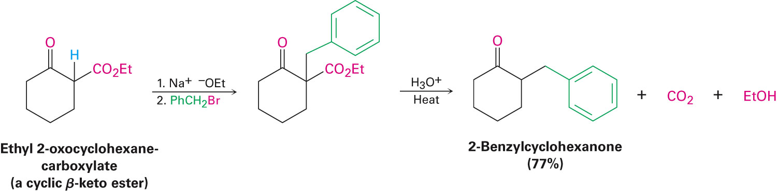
Generalization: β-Keto Esters
Sequence
Enolate ion formation
Alkylation
Hydrolysis/decarboxylation
Cyclic β-keto esters give 2-substituted cyclohexanones

Slide 45
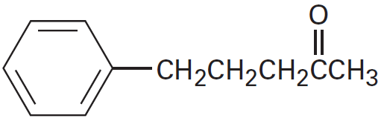
Worked Example
What alkyl halides would be used to prepare the following ketones by an acetoacetic ester synthesis

Slide 46
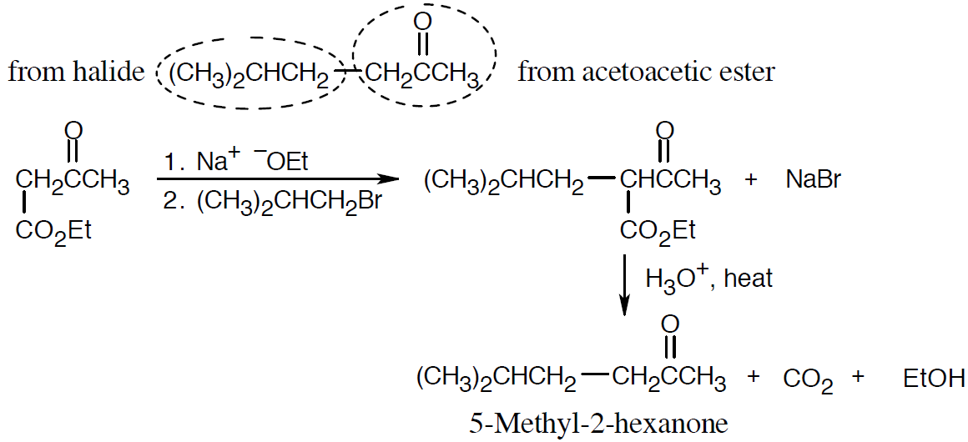
Worked Example
Solution:
The methyl ketone component comes from acetoacetic ester; the other component comes from a halide

Slide 47
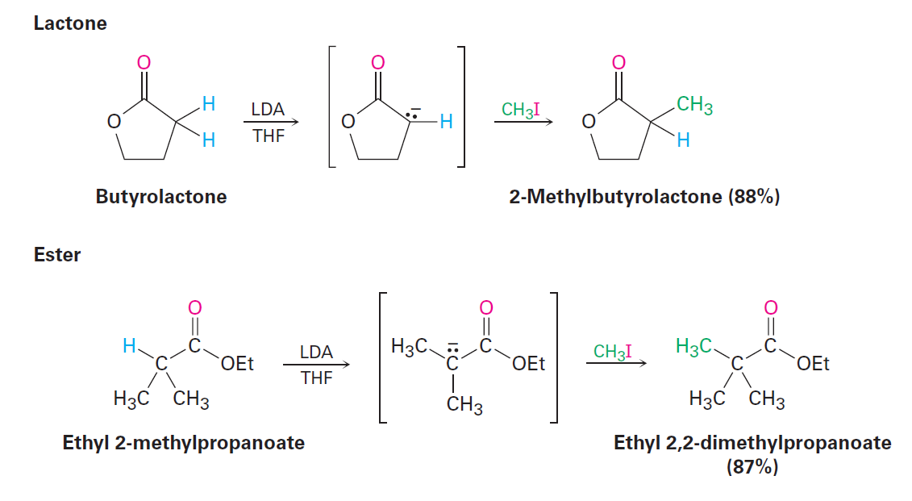
Direct Alkylation of Ketones, Esters, and Nitriles
Ketones, esters, and nitriles can all be alkylated using LDA or related dialkylamide bases in THF

Slide 48
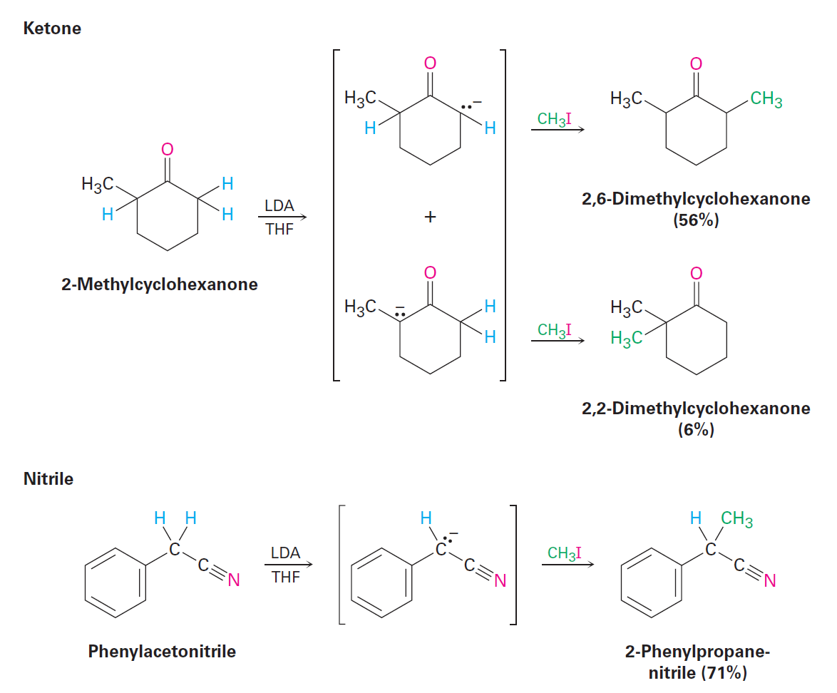
Direct Alkylation of Ketones, Esters, and Nitriles

Slide 49
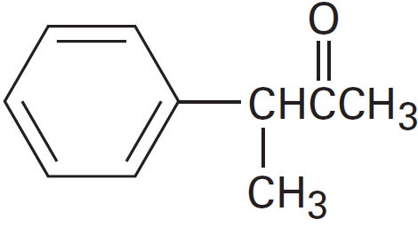
Worked Example
Show how the compound given below might be prepared
Using an alkylation reaction as the key step

Slide 50
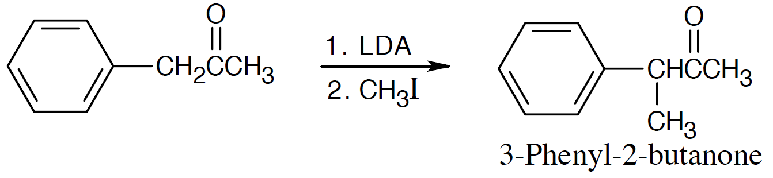
Worked Example
Solution:
The phenyl group can help stabilize the enolate anion intermediate
Alkylation occurs at the carbon next to the phenyl group

Slide 51
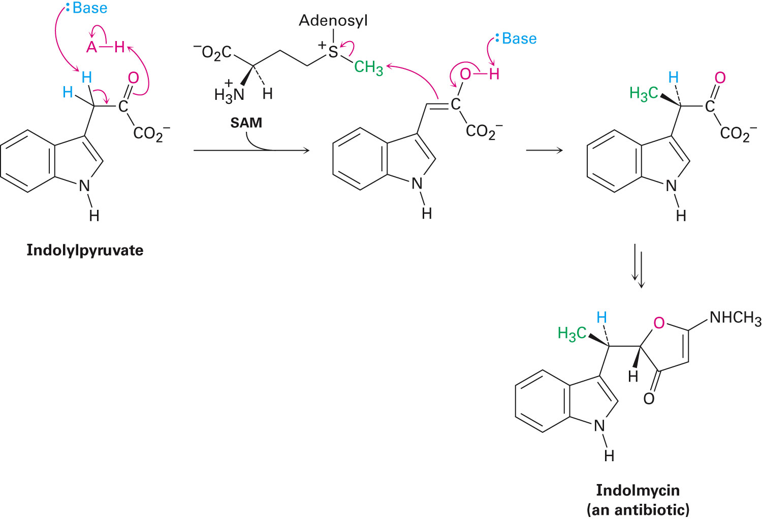
Figure 22.6 - Biosynthesis of Indolmycin from Indolylpyruvate

Slide 52
Summary
The α-substitution reaction of a carbonyl compound through either an enol or enolate ion intermediate is one of the four fundamental reaction types in carbonyl-group chemistry
Enol tautomers are normally present only to a small extent at equilibrium and are difficult to isolate
React with electrophiles in an α-substitution reaction
Malonic ester synthesis converts an alkyl halide into a carboxylic acid

Slide 53
Summary
Acetoacetic ester synthesis converts an alkyl halide into a methyl ketone

